Slide 1
ADD PROJECT
BY MEHVISH AKTHAR 1ms15ec057
NAMRATA B 1ms15bt026
AISHWARYA 1ms15is010
Thrapthi hegde h 1ms15cs131

Slide 2
introduction
Application
Agriculture Measuring soil moisture is important for agricultural applications to help farmers manage their irrigation systems more efficiently. Knowing the exact soil moisture conditions on their fields, not only are farmers able to generally use less water to grow a crop, they are also able to increase yields and the quality of the crop by improved management of soil moisture during critical plant growth stages.
Landscape irrigation
In urban and suburban areas, landscapes and residential lawns are using soil moisture sensors to interface with an irrigation controller. Connecting a soil moisture sensor to a simple irrigation clock will convert it into a "smart" irrigation controller that prevents irrigation cycles when the soil is already wet, e.g. following a recent rainfall event.
Golf courses are using soil moisture sensors to increase the efficiency of their irrigation systems to prevent over-watering and leaching of fertilizers and other chemicals into the ground.

Slide 3
Research
Soil moisture sensors are used in numerous research applications, e.g. in agricultural science and horticulture including irrigation planning, climate research, or environmental science including solute transport studies and as auxiliary sensors for soil respiration measurements.
Simple sensors for gardeners
Relatively cheap and simple devices that do not require a power source are available for checking whether plants have sufficient moisture to thrive. After inserting a probe into the soil for approximately 60 seconds, a meter indicates if the soil is too dry, moist or wet for plants.

Slide 4
COMPONENTS USED:
1) Soil moisture sensors- measure the volumetric water content in soil.] Since the direct gravimetric measurement of free soil moisture requires removing, drying, and weighting of a sample, soil moisture sensors measure the volumetric water content indirectly by using some other property of the soil, such as electrical resistance, dielectric constant, or interaction with neutrons, as a proxy for the moisture content. The relation between the measured property and soil moisture must be calibrated and may vary depending on environmental factors such as soil type, temperature, or electric conductivity. Reflected microwave radiation is affected by the soil moisture and is used for remote sensing in hydrology and agriculture. Portable probe instruments can be used by farmers or gardeners.
Soil moisture sensors typically refer to sensors that estimate volumetric water content. Another class of sensors measure another property of moisture in soils called water potential; these sensors are usually referred to as soil water potential sensors and include tensiometers and gypsum blocks.

Slide 5
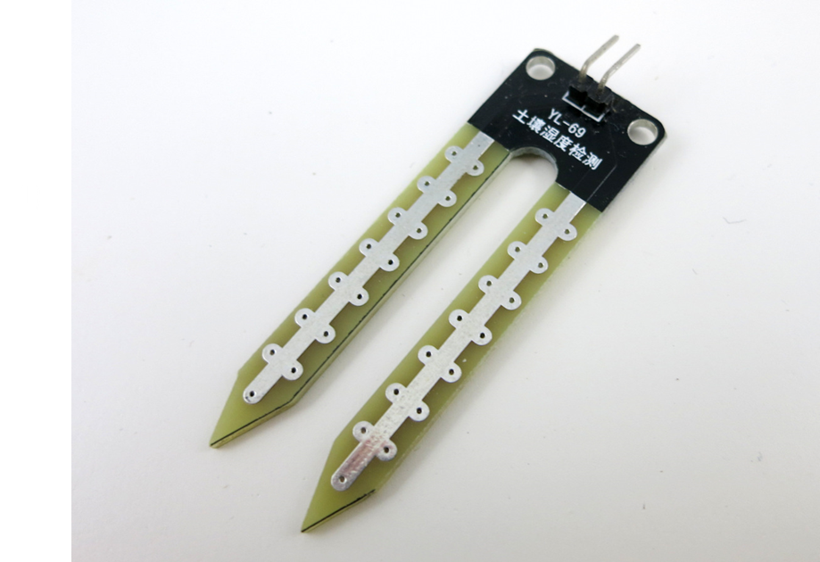

Slide 6
Bread board
  A breadboard is a construction base for prototyping of electronics. Originally it was literally a bread board, a polished piece of wood used for slicing bread. In the 1970s the solderless breadboard (AKA plugboard, a terminal array board) became available and nowadays the term "breadboard" is commonly used to refer to these. "Breadboard" is also a synonym for "prototype".^{[1]}
Because the solderless breadboard does not require soldering, it is reusable. This makes it easy to use for creating temporary prototypes and experimenting with circuit design. For this reason, solderless breadboards are also extremely popular with students and in technological education. Older breadboard types did not have this property. A stripboard (Veroboard) and similar prototyping printed circuit boards, which are used to build semi-permanent soldered prototypes or one-offs, cannot easily be reused. A variety of electronic systems may be prototyped by using breadboards, from small analog and digital circuits to complete central processing units (CPUs).

Slide 7
BUS STRIPS
To provide power to the electronic components.
A bus strip usually contains two rows: one for ground and one for a supply voltage. However, some breadboards only provide a single-row power distributions bus strip on each long side. Typically the row intended for a supply voltage is marked in red, while the row for ground is marked in blue or black. Some manufacturers connect all terminals in a column. Others just connect groups of, for example, 25 consecutive terminals in a column. The latter design provides a circuit designer with some more control over crosstalk (inductively coupled noise) on the power supply bus. Often the groups in a bus strip are indicated by gaps in the color marking.
Bus strips typically run down one or both sides of a terminal strip or between terminal strips. On large breadboards additional bus strips can often be found on the top and bottom of terminal strips.
Note there are two different common alignments for the power bus strips. On small boards, with about 30 rows, the holes for the power bus are often aligned between the signal holes. On larger boards, about 63 rows, the power bus strip holes are often in alignment with the signal holes. This makes some accessories designed for one board type incompatible with the other. For example, some Raspberry Pi GPIO to breadboard adapters use offset aligned power pins, making them not fit breadboards with aligned power bus rows. There are no official standards, so the users need to pay extra attention to the compatibility between a specific model of breadboard and a specific accessory. Vendors of accessories and breadboards are not always clear in their specifications of which alignment they use. Seeing a close up photograph of the pin/hole arrangement can help determine compatibility.
Some manufacturers provide separate bus and terminal strips. Others just provide breadboard blocks which contain both in one block. Often breadboard strips or blocks of one brand can be clipped together to make a larger breadboard.
In a more robust variant, one or more breadboard strips are mounted on a sheet of metal. Typically, that backing sheet also holds a number of binding posts. These posts provide a clean way to connect an external power supply. This type of breadboard may be slightly easier to handle. Several images in this article show such solderless breadboards.

Slide 8
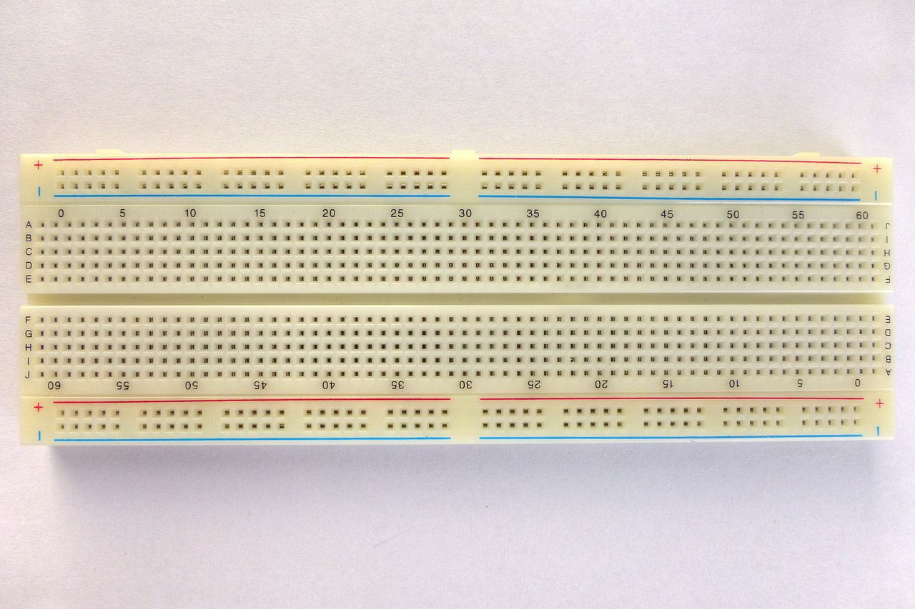
Bread board image

Slide 9
Jump wires
Jump wires
Jump wires (also called jumper wires) for solderless breadboarding can be obtained in ready-to-use jump wire sets or can be manually manufactured. The latter can become tedious work for larger circuits. Ready-to-use jump wires come in different qualities, some even with tiny plugs attached to the wire ends. Jump wire material for ready-made or homemade wires should usually be 22 AWG (0.33 mm²) solid copper, tin-plated wire - assuming no tiny plugs are to be attached to the wire ends. The wire ends should be stripped ³⁄₁₆ to ⁵⁄₁₆ in (4.8 to 7.9 mm). Shorter stripped wires might result in bad contact with the board's spring clips (insulation being caught in the springs). Longer stripped wires increase the likelihood of short-circuits on the board. Needle-nose pliers and tweezers are helpful when inserting or removing wires, particularly on crowded boards.
Differently colored wires and color-coding discipline are often adhered to for consistency. However, the number of available colors is typically far fewer than the number of signal types or paths. Typically, a few wire colors are reserved for the supply voltages and ground (e.g., red, blue, black), some are reserved for main signals, and the rest are simply used where convenient. Some ready-to-use jump wire sets use the color to indicate the length of the wires, but these sets do not allow a meaningful color-coding schema.

Slide 10
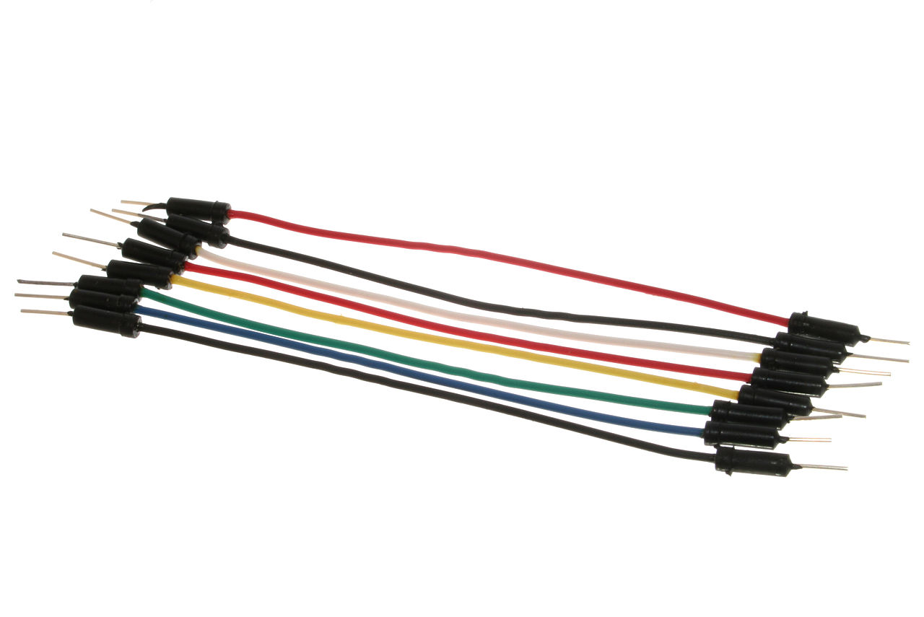
Jump wire image

Slide 11
Arduino uno board
An Arduino board consists of an Atmel 8-, 16- or 32-bit AVR microcontroller (although since 2015 other makers' microcontrollers have been used) with complementary components that facilitate programming and incorporation into other circuits. An important aspect of the Arduino is its standard connectors, which let users connect the CPU board to a variety of interchangeable add-on modules termed shields. Some shields communicate with the Arduino board directly over various pins, but many shields are individually addressable via an I²C serial bus—so many shields can be stacked and used in parallel. Before 2015, Official Arduinos had used the Atmel megaAVR series of chips, specifically the ATmega8, ATmega168, ATmega328, ATmega1280, and ATmega2560. In 2015, units by other producers were added. A handful of other processors have also been used by Arduino compatible devices. Most boards include a 5 V linear regulator and a 16 MHz crystal oscillator (or ceramic resonator in some variants), although some designs such as the LilyPad run at 8 MHz and dispense with the onboard voltage regulator due to specific form-factor restrictions. An Arduino's microcontroller is also pre-programmed with a boot loader that simplifies uploading of programs to the on-chip flash memory, compared with other devices that typically need an external chip programmer. This makes using an Arduino more straightforward by allowing the use of an ordinary computer as the programmer. Currently, optiboot bootloader is the default bootloader installed on Arduino UNO.

Slide 12
At a conceptual level, when using the Arduino integrated development environment, all boards are programmed over a serial connection. Its implementation varies with the hardware version. Some serial Arduino boards contain a level shifter circuit to convert between RS-232 logic levels and transistor–transistor logic (TTL) level signals. Current Arduino boards are programmed via Universal Serial Bus (USB), implemented using USB-to-serial adapter chips such as the FTDI FT232. Some boards, such as later-model Uno boards, substitute the FTDI chip with a separate AVR chip containing USB-to-serial firmware, which is reprogrammable via its own ICSP header. Other variants, such as the Arduino Mini and the unofficial Boarduino, use a detachable USB-to-serial adapter board or cable, Bluetooth or other methods, when used with traditional microcontroller tools instead of the Arduino IDE, standard AVR in-system programming (ISP) programming is used.

Slide 13
The Arduino board exposes most of the microcontroller's I/O pins for use by other circuits. The Diecimila,^{[a]} Duemilanove,^{[b]} and current Uno^{[c]} provide 14 digital I/O pins, six of which can produce pulse-width modulated signals, and six analog inputs, which can also be used as six digital I/O pins. These pins are on the top of the board, via female 0.1-inch (2.54 mm) headers. Several plug-in application shields are also commercially available. The Arduino Nano, and Arduino-compatible Bare Bones Board^{[6]} and Boarduino^{[7]} boards may provide male header pins on the underside of the board that can plug into solderless breadboards.
Many Arduino-compatible and Arduino-derived boards exist. Some are functionally equivalent to an Arduino and can be used interchangeably. Many enhance the basic Arduino by adding output drivers, often for use in school-level education, to simplify making buggies and small robots. Others are electrically equivalent but change the form factor, sometimes retaining compatibility with shields, sometimes not. Some variants use different processors, of varying compatibility.

Slide 14
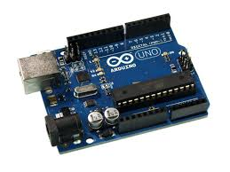
Arduino uno board image

Slide 15
relay
A relay is an electrically operated switch. Many relays use an electromagnet to mechanically operate a switch, but other operating principles are also used, such as solid-state relays. Relays are used where it is necessary to control a circuit by a separate low-power signal, or where several circuits must be controlled by one signal. The first relays were used in long distance telegraph circuits as amplifiers: they repeated the signal coming in from one circuit and re-transmitted it on another circuit. Relays were used extensively in telephone exchanges and early computers to perform logical operations.
A type of relay that can handle the high power required to directly control an electric motor or other loads is called a contactor. Solid-state relays control power circuits with no moving parts, instead using a semiconductor device to perform switching. Relays with calibrated operating characteristics and sometimes multiple operating coils are used to protect electrical circuits from overload or faults; in modern electric power systems these functions are performed by digital instruments still called "protective relays".

Slide 16
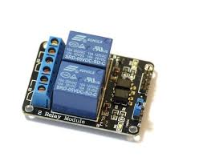
Relay image

Slide 17
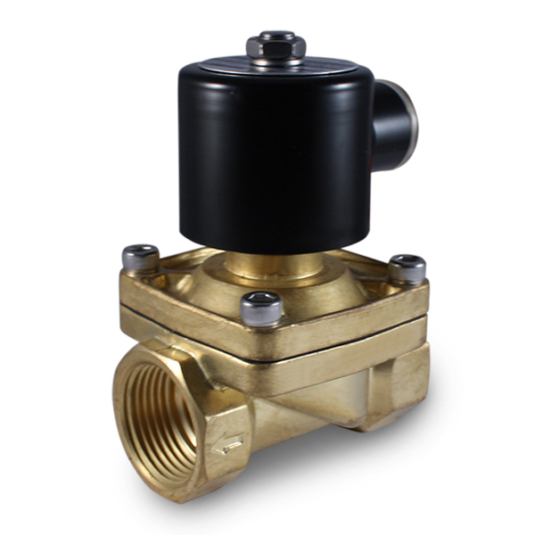
ELECTRIC VALVE:
A 2-way valve, for example, has 2 ports; if the valve is open, then the two ports are connected and fluid may flow between the ports; if the valve is closed, then ports are isolated.
If the valve is open when the solenoid is not energized, then the valve is termed normally open (N.O.). Similarly, if the valve is closed when the solenoid is not energized, then the valve is termed normally closed.
Solenoid valves are characterized by how they operate. A small solenoid can generate a limited force. If that force is sufficient to open and close the valve, then a direct acting solenoid valve is possible.

Slide 18
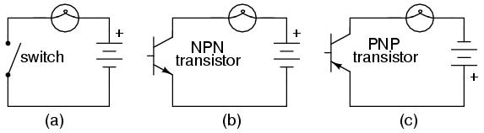
NPN Transistor as a Switch
Based on the voltage applied at the base terminal of a transistor switching operation is performed.
When a sufficient voltage (V_{in} > 0.7 V) is applied between the base and emitter, collector to emitter voltage is approximately equal to 0. Therefore, the transistor acts as a short circuit. The collector current V_{cc}/R_{c} flows through the transistor.
Similarly, when no voltage or zero voltage is applied at the input, transistor operates in cutoff region and acts as an open circuit.
In this type of switching connection, load is connected to the switching output with a reference point.
Thus, when the transistor is switched ON, current will flow from source to ground through the load.

Slide 19
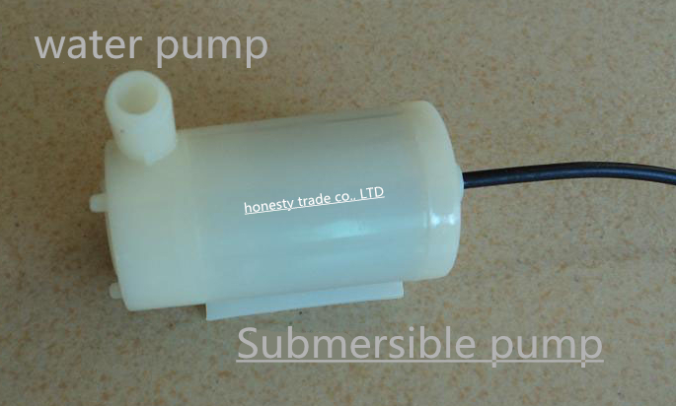
Pump
A pump is a device that moves fluids (liquids or gases), or sometimes slurries, by mechanical action.
Pumps operate by some mechanism (typically reciprocating or rotary), and consume energy to perform mechanical work by moving the fluid.

Slide 20
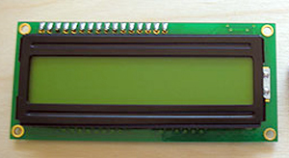
LCD Display
A liquid-crystal display (LCD) is a flat-panel display or other electronic visual display that uses the light-modulating properties of liquid crystals.
Liquid crystals do not emit light directly. LCDs are available to display arbitrary images (as in a general-purpose computer display) or fixed images with low information content, which can be displayed or hidden, such as preset words, digits, and 7-segmentdisplays, as in a digital clock.

Slide 21
Connections:

Slide 22
Connect the soil sensor to the arduino:
  Soil moisture sensor is in interface with an npn transistor.
  Connect the Vcc pin on the transistor to the +5V pin on the arduino.
  Connect the ground pin on the transistor to the ground pin on the arduino.
  Root the analog output pin to one of the analog input pins of the arduino board.

Slide 23
Connect the pump to the arduino:
Initially a transistor and a resistor are inserted into the holes of the breadboard. Connections are made with the help of few jumper wires.
Base of the transistor is connected to the resistor. The other end of the resistor is connected to the digital output pin of the arduino.
Emitter of the transistor is grounded.
Collector of the transistor is connected to the negative of the pump motor.
The positive end of the pump motor is connected to +5V pin of the arduino.

Slide 24
Usage of a relay:
Pump used is then connected to the electric valve which later waters the plant if required.
Since we are using an electric valve which requires 12V supply and because the max output voltage given by arduino is 5V we make use of a relay.
The digital output pin of arduino is connected to the relay switch.
This switch is then connected to two batteries in series which is then connected to the electric valve.
This ensures 12V supply to the valve whenever the digital output is high.

Slide 25
Uploading the code to the arduino:
serial.begin:
To see the data from the moisture sensor in our serial input window.
sensorvalue=analogread(A0):
To receive the sensor value readings depending on the moisture content detected.
serial.println(sensorvalue):
To print the sensor value with the delay of the time mentioned ( Ex : delay(100); )

Slide 26
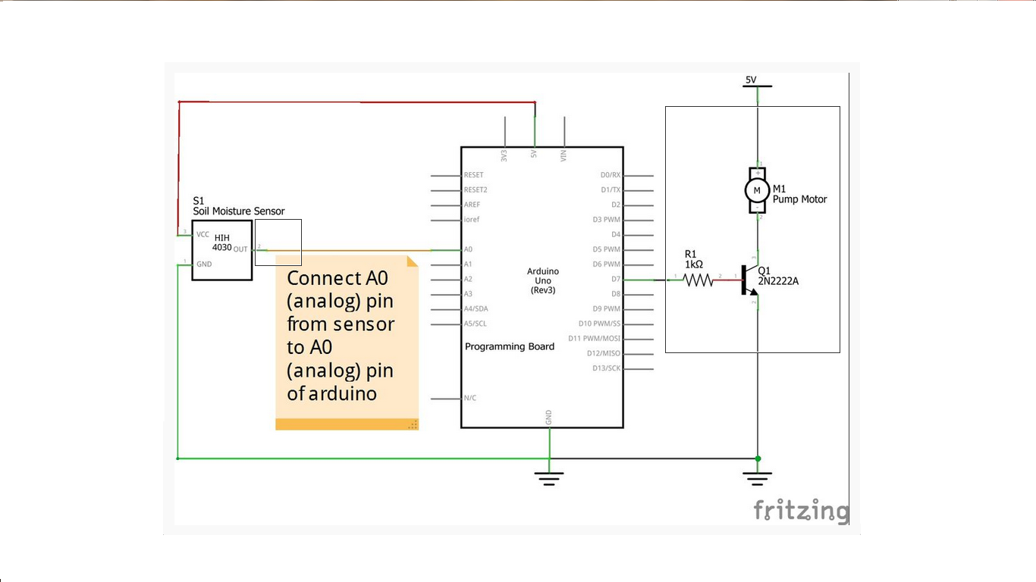

Slide 27
To wire the LCD screen to the board, connect the following pins:
LCD RS pin to digital pin 12
LCD Enable pin to digital pin 11
LCD D4 pin to digital pin 5
LCD D5 pin to digital pin 4
LCD D6 pin to digital pin 3
LCD D7 pin to digital pin 2
Additionally, wire a 10k pot to +5V and GND, with it's wiper (output) to LCD screens VO pin (pin3).

Slide 28
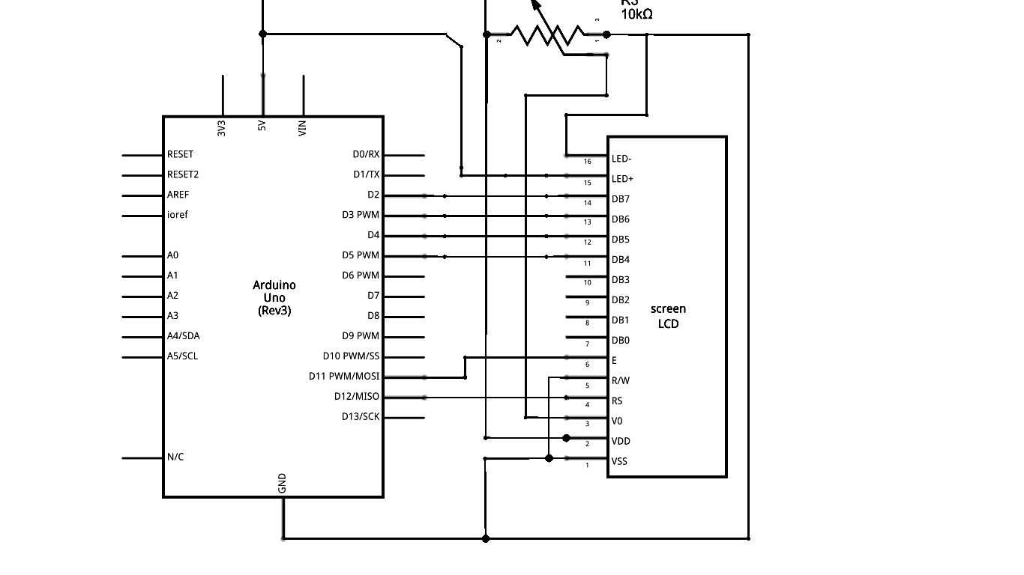

Slide 29
WORKING:

Slide 30
We know that water make the soil more prone to electric conductivity resulting in less resistance in the soil where on the other hand dry soil has poor electric conductivity thus more resistance in soil. Soil moisture sensor is designed using these properties.
The two probes of a soil sensor is inserted into the soil which measures the voltage with the help of the npn transistor.
Since the sensor provides analog voltage as output, we use analog i/o pin which is given as an input to the arduino.
It is observed that the sensor value falls as the moisture content in the soil is increased.

Slide 31
If the moisture content in the soil is low , then the conductivity reduces which results in the high resistance and hence a high voltage.
The sensor value readings thus obtained by the high voltage given as an analog input will clearly indicate that the moisture content in the soil is lower than the minimum moisture content mentioned in the code and hence a high digital output voltage of 5V is obtained.
If the moisture content in the soil is high, then the analog input to the arduino would be low and hence the digital output voltage would be 0V.
The transistor used act as a switch . When the digital output is high, transistor is in the ON state, and hence it runs the pump. When the output is low , it is in the OFF State and hence the pump won’t run.

Slide 32
The digital output is also given to the relay switch .
If a voltage of 5V is given, then the switch would be closed and hence the batteries connected in series would supply 12V required voltage to the electric valve and this ensures the supply of water to the dry soil.
If a voltage of 0V is given then the switch is opened and thus the electric valve will not supply water to the soil with the required moisture.
The LCD display used displays the percentage of dryness of the soil.

Slide 33
Conclusion
The Arduino based soil moisture sensor has been designed and tested successfully.It has been developed by integratedfeatures of all the hardware components used.The system has been tested to work automatically.The moisture sensors measure the moisture level(water content) of different plants.
If the moisture level is found to be below the desrid level,the moisture sensor sends the signals to the arduino which triggers the water pump to turn ON and supply water to the respective plant using electric valve.
When desired moisture level is reached,the system halts on its own and pump is turned OFF. Thus the functionality has been tested thoroughly and successfully.

